Slide 1
Building a Protection Severity Index
Data Analysis Workshop

Slide 2
Building severity Index
Objective of the session:
Building such index, also called composite indicator, is among the regular and expected task of any humanitarian data analyst.
Objective is simplify information into a simple indicator that can reduce information overflow.
Informs the sectoral and inter-sectoral discussions in order the facilitate comparison of needs across geographic areas.

Slide 3
Methodology
When developing severity index, each steps comes with methodological questions:
How to select and organize indicators?
How to calculate and reshape them?
How to assemble them together (aggregation and weighting).

Slide 4
Dataset
Key Informant Interview for Hurricane Dorian, Bahamas - available through HDX here
Collected at the beginning of November 2019 by IOM/DTM in the Bahamas. See initial report.
Covers Abaco Island which has been severely hit by Hurricane Dorian on 1-3 September 2019.

Slide 5
Theoretical Severity Framework
qlabel | Calculation | Polarity
Concerning hierarchy of unmet needs | scored | Negative (the higher score, the more severe)
Community Relation Level | scored | Negative (the higher score, the more severe)
Relation with Host Community | scored | Negative (the higher score, the more severe)
Women Good safety | scored | Positive (the higher score, the less severe)
Men Good Safety | scored | Positive (the higher score, the less severe)
Child Good Safety | scored | Positive (the higher score, the less severe)
Reported Security Incident | binary | Negative (the higher score, the more severe)
Reported Immigration Visit | binary | Negative (the higher score, the more severe)
Positive Referral Mechanisms | binary | Positive (the higher score, the less severe)
Positive Safe/Recreational Places | binary | Positive (the higher score, the less severe)
Positive Diversity of Information source | scored | Positive (the higher score, the less severe)

Slide 6
Calculating sub-indicator
Different calculations were used depending on the type of questions used in the severity framework:
For binary questions, negative questions receive a score of 1 when answered positively, and 0 when “no”
Some select_one response choices is ordinal data with an imputed ordered response, where the max score is given either to the best or worst possible choice.
Some select_multiple questions might have many dummy variables corresponded to the question and the sum of these scores represented the highest score possible. Other select_multiple response choices are discrete choice data with nominal responses; each answer in the select_multiple are weighted according their severity.

Slide 7
Sub-Indicator Polarity
The polarity of a sub-indicator is the sign of the relationship between the indicator and the phenomenon to be measured (for instance, in a well-being index, “GDP per capita” has ‘positive’ polarity and “Unemployment rate” has ‘negative’ polarity).
In this case, we have 2 options for such directional adjustments:
Negative (the higher score, the more severe)
Positive (the higher score, the less severe)

Slide 8
Data Normalization
Allows for adjustments of distribution (similar range of variation) and scale (common scale) of sub-indicators that may reflect different units of measurement and different ranges of variation. Different possible options:
A z-score approach: Imposes a distribution with mean zero and variance 1. Standardized scores which are below average will become negative, implying that further geometric aggregation will be prevented.
A min-max approach: Same range of variation [0,1]) but not same variance. This method is very sensitive to extreme values/outliers
A ranking method: Scores are replaced by ranks – e.g. the highest score receives the first ranking position (rank 1).

Slide 9
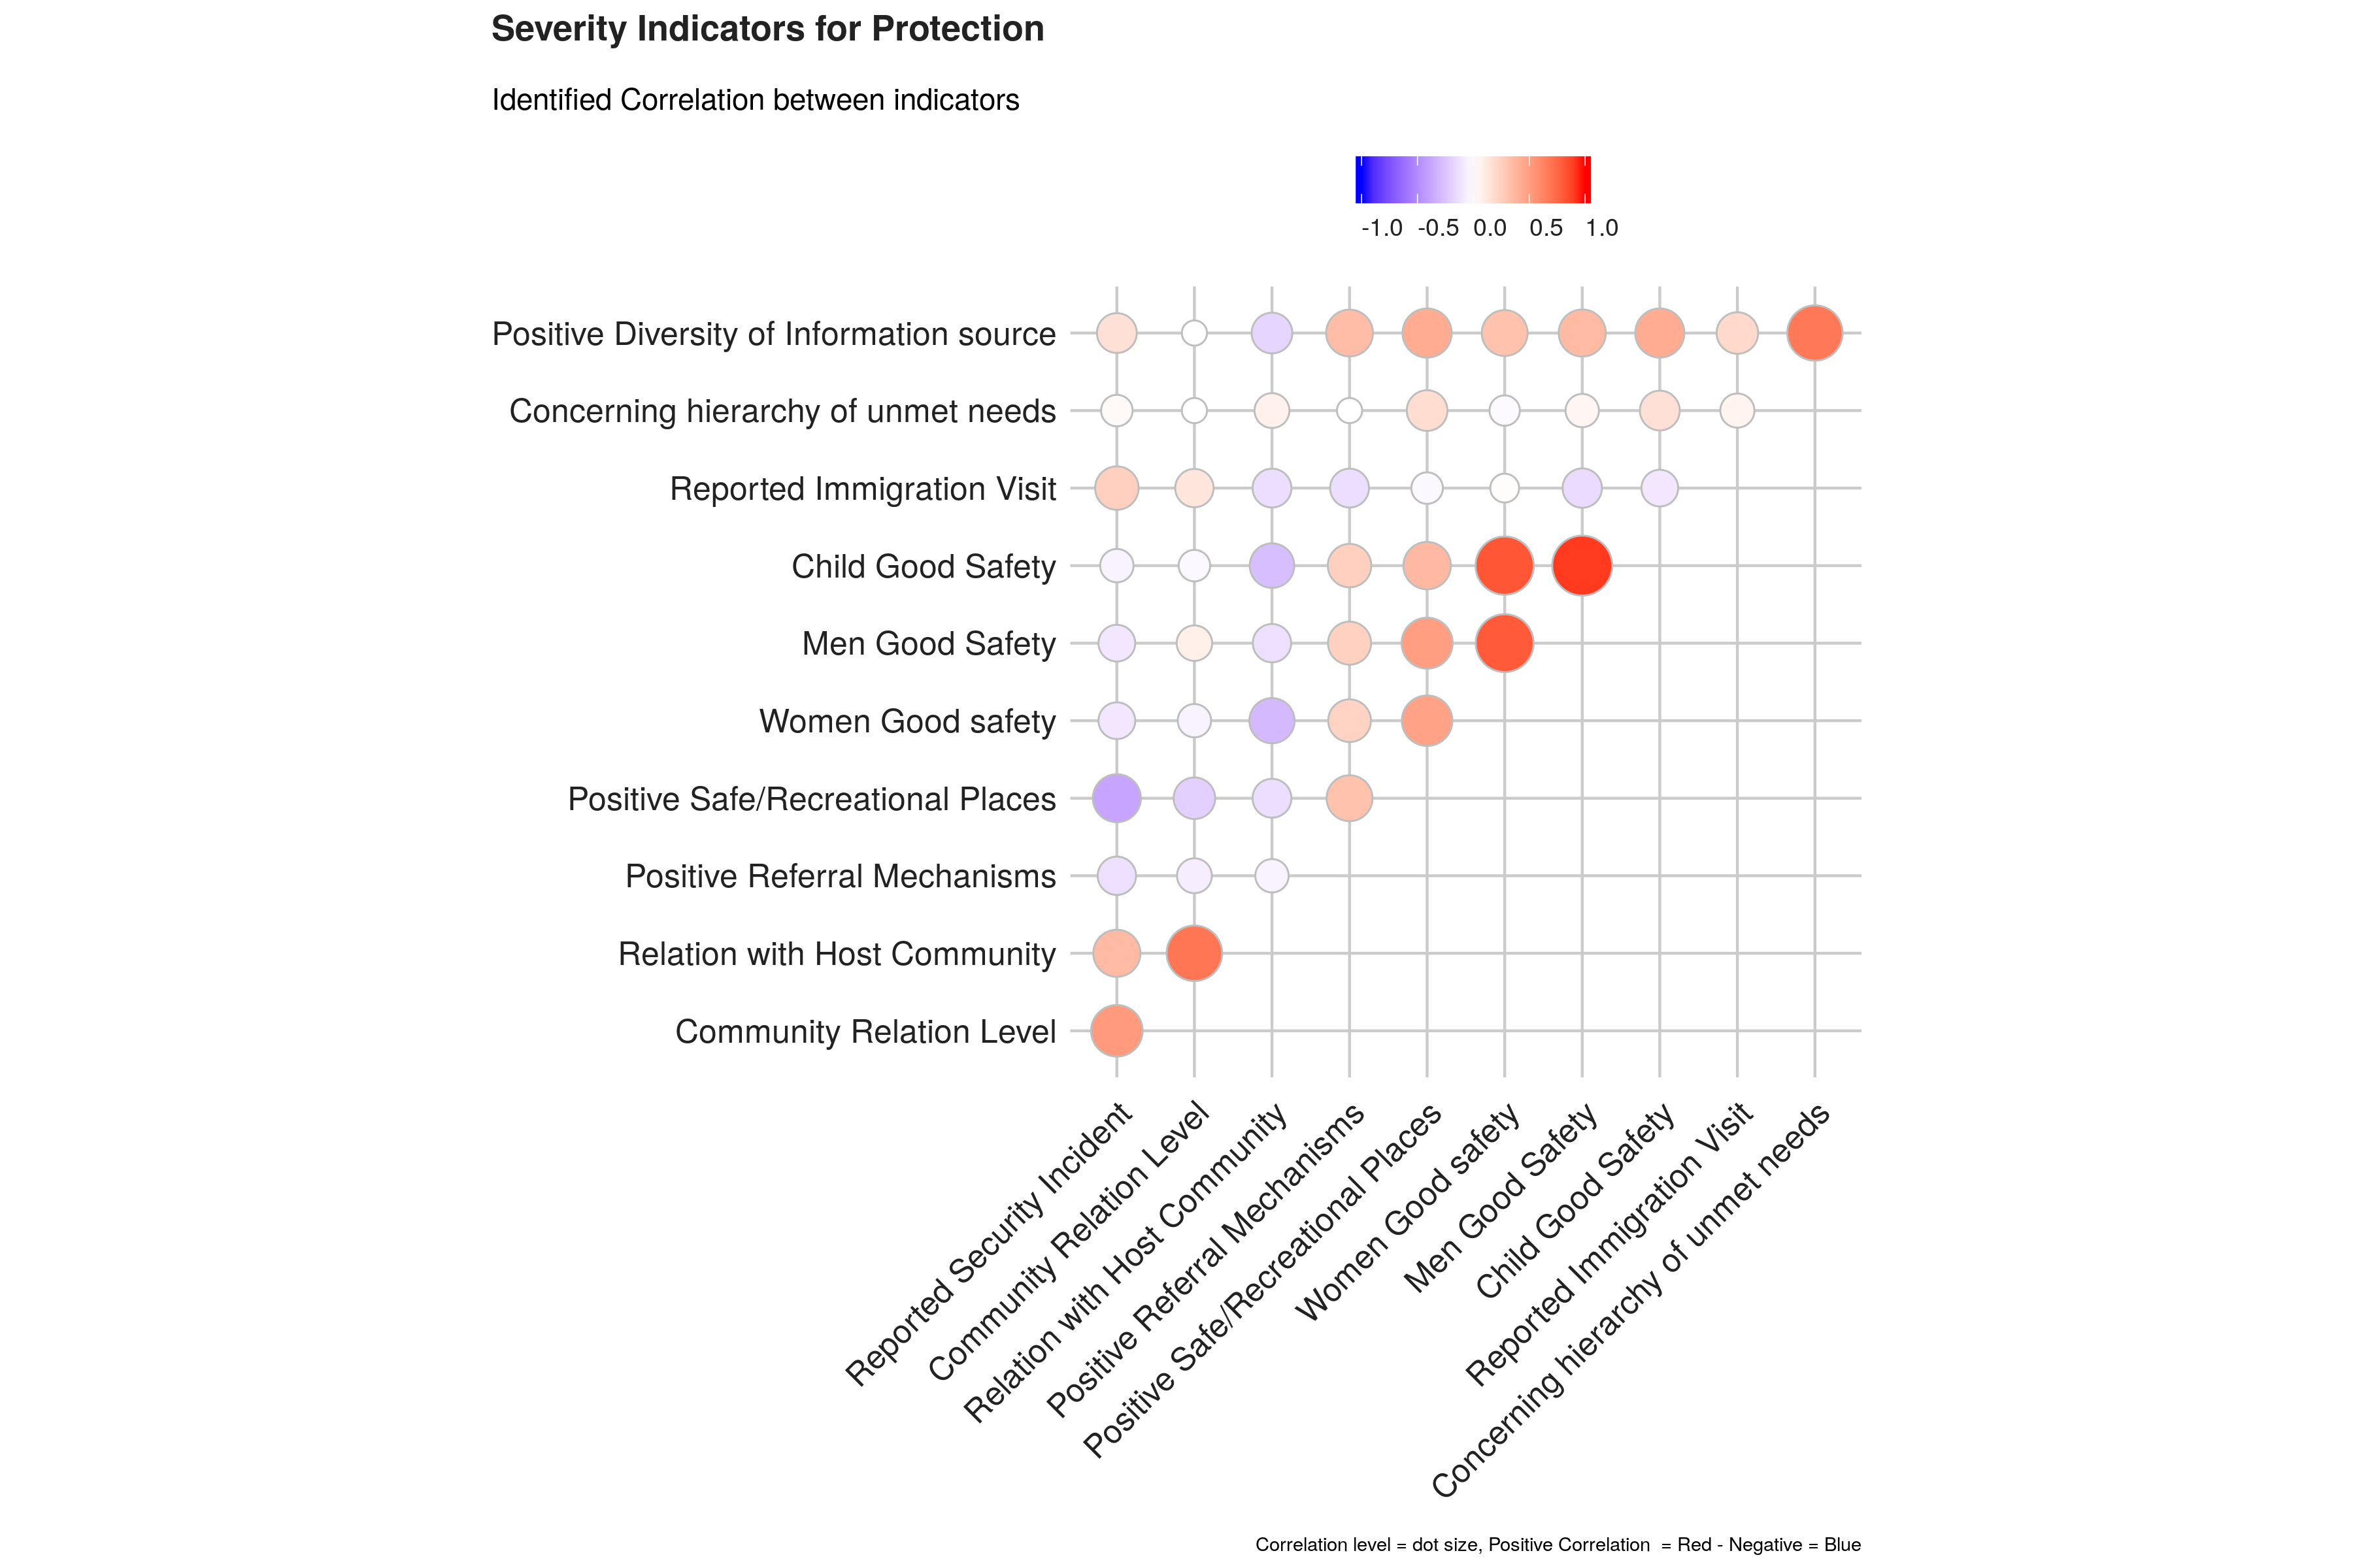
Correlation Analysis

Slide 10
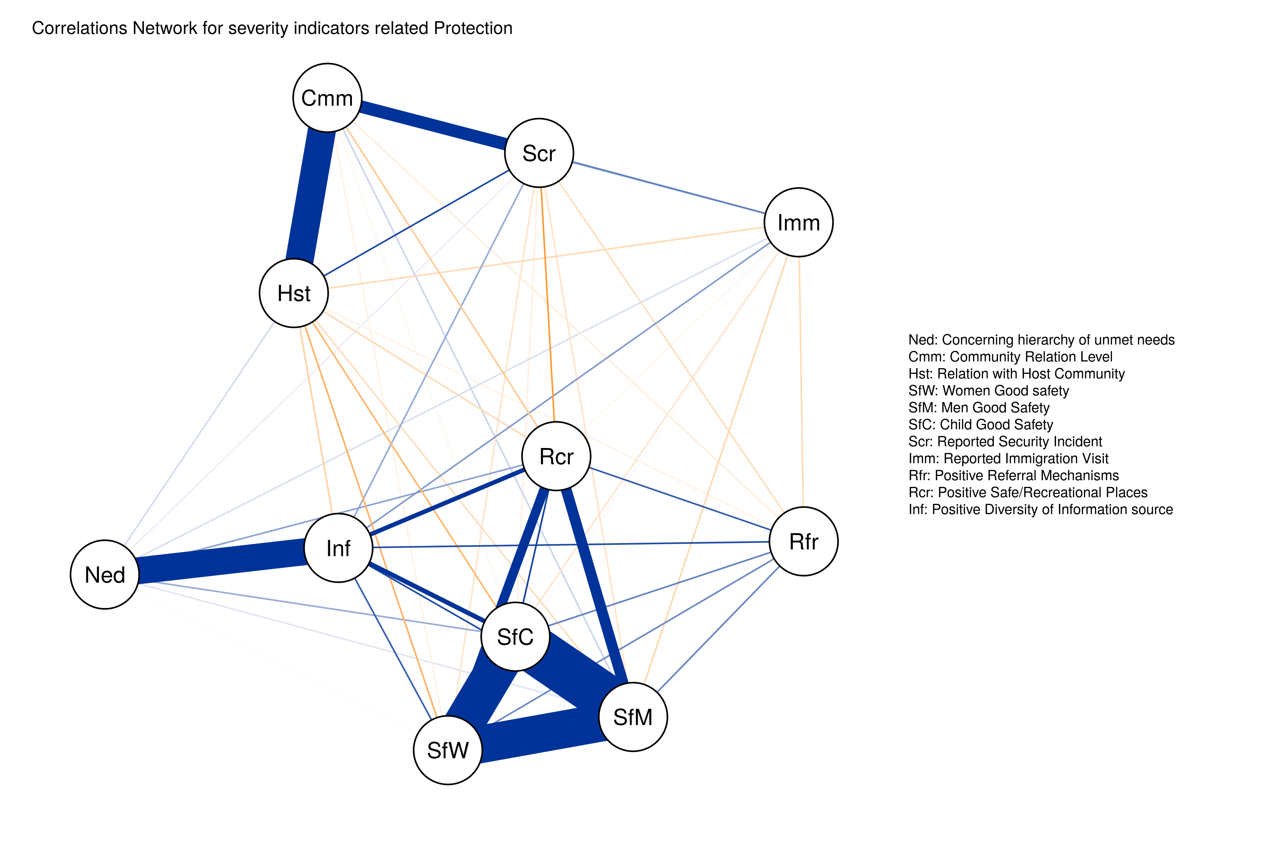
Correlations Network

Slide 11
Consistency
Cronbach’s alpha, (or coefficient alpha), measures reliability / consistency (i.e. how well a test measures what it should: measure of the stability of test scores).
As a rule of thumbs, a score of more than 0.7 indicates an acceptable level of consistency: - A high level for alpha may mean that all indicators are highly correlated (meaning we have redundant indicators representing the same thing…). - A low value for alpha may mean that there are not enough indicators or that the indicators are poorly interrelated.
The Cronbach Alpha measure of consistency for this combination of indicators is 0.75 .

Slide 12
Aggregation & Weighting
For weighting, the main issue to address is related to the concept of compensability. Namely the question is to know to what extent can we accept that the high score of an indicator go to compensate the low score of another indicator?
This problem of compensability is intertwined with the issue of attribution of weights for each sub-indicator in order to calculate the final aggregation.
Simply using “equal weight” (all indicators account for the same in the final index) and “arithmetic aggregation” (all indicators are substituable) is unlikely to depict the complex issue of Humanitarian Severity and is likely to comes with the risk of misrepresenting the reality.

Slide 13
Benefice of the Doubt
Benefit of the Doubt approach (BoD), application of Data Envelopment Analysis (DEA), ensures that weights are endogenously determined by the observed performances. Benchmark is not based on theoretical bounds, but it’s a linear combination of the observed best performances.
Directional Benefit of the Doubt (D-BoD) model enhances non-compensatory property by introducing directional penalties in a standard BoD model in order to consider the preference structure among simple indicators.
Robust Benefit of the Doubt approach (RBoD) is an extension of BoD based on the concept of the expected minimum input function.
Benefit of the Doubt approach (BoD) index with constraints on weights allows for constraints (so that there is none not valued) and with a penalty.

Slide 14
Other algorithms
Factor analysis groups together simple indicators to estimate a composite indicator that captures as much as possible of the information common to individual indicators.
Mean-Min Function (MMF) is an intermediate case between arithmetic mean, according to which no unbalance is penalized, and min function, according to which the penalization is maximum.
Geometric aggregation uses the geometric mean to aggregate the single indicators and therefore allows to bypass the full compensability hypothesis using geometric mean.
Mazziotta-Pareto Index (MPI) transforms a set of individual indicators in standardized variables and summarizes them using an arithmetic mean adjusted by a “penalty” coefficient related to the variability of each unit.
Wroclaw taxonomy method is based on the distance from a theoretical unit characterized by the best performance for all indicators considered.

Slide 15
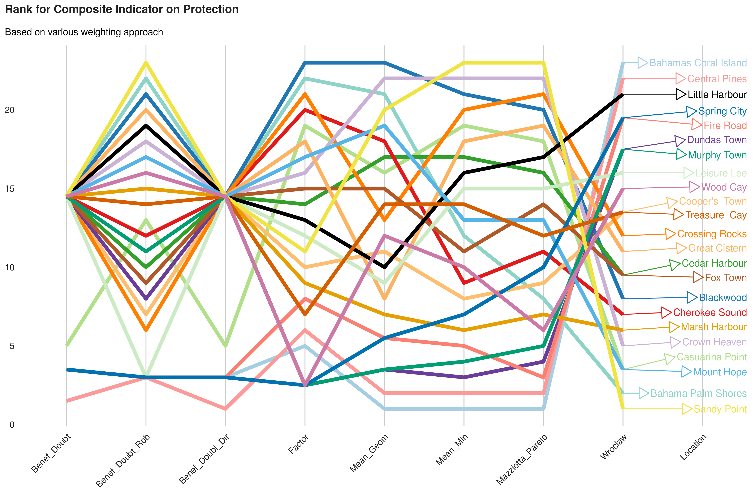
Compare Output

Slide 16
Robust Benefit of the Doubt approach

Slide 17
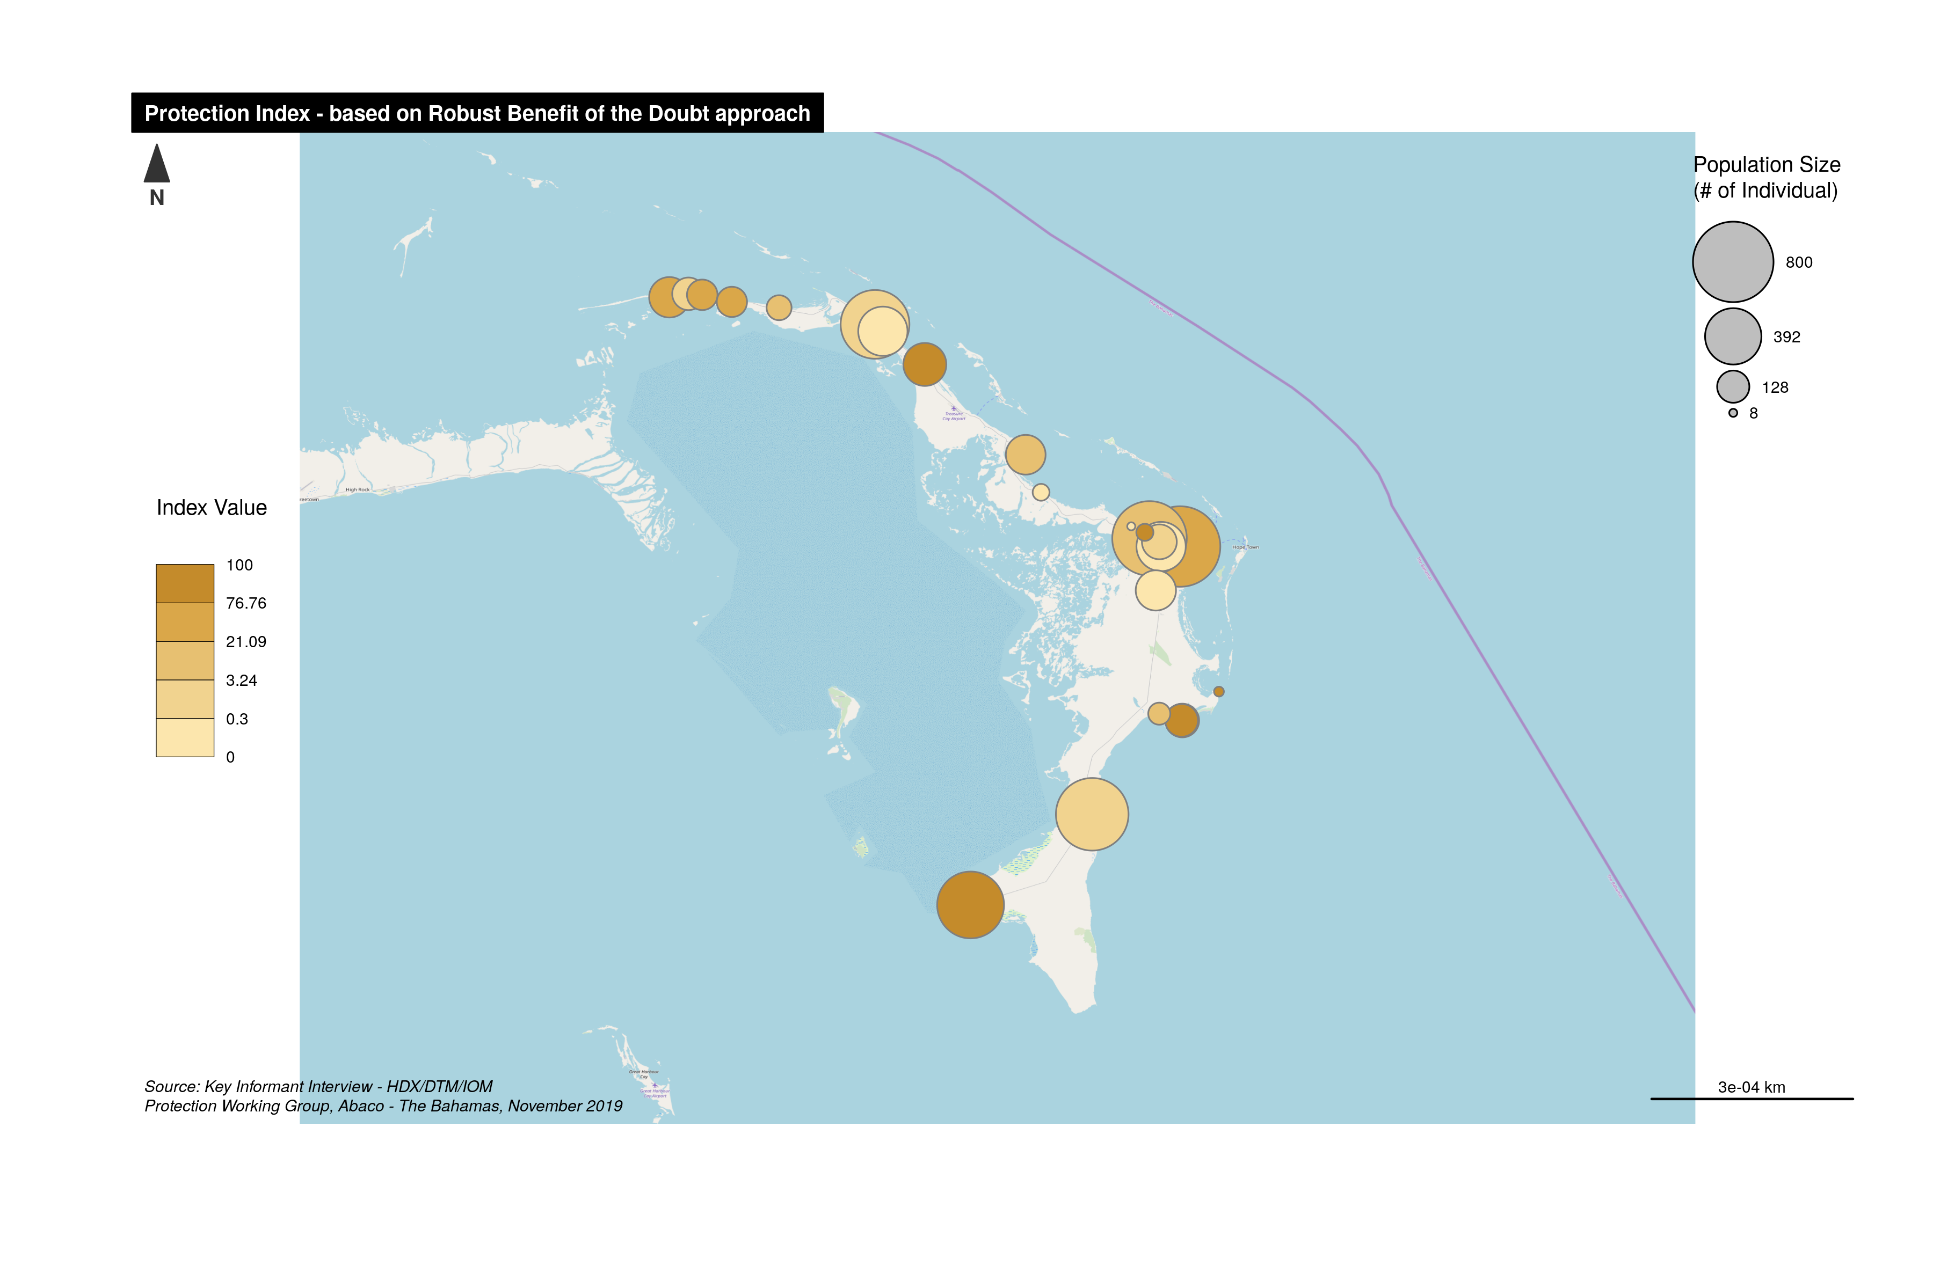
Severity Index Map

Slide 18
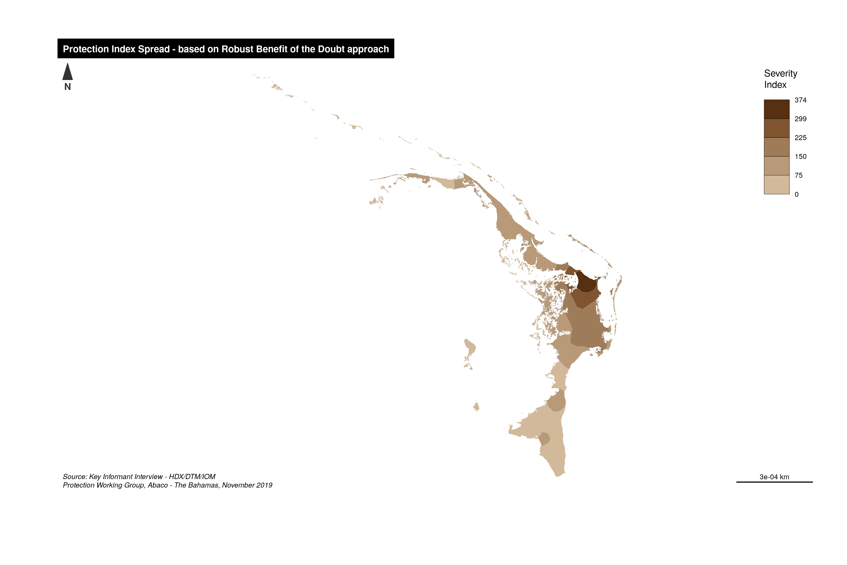
Now getting smooth map

Slide 19
Factor analysis componnents

Slide 20
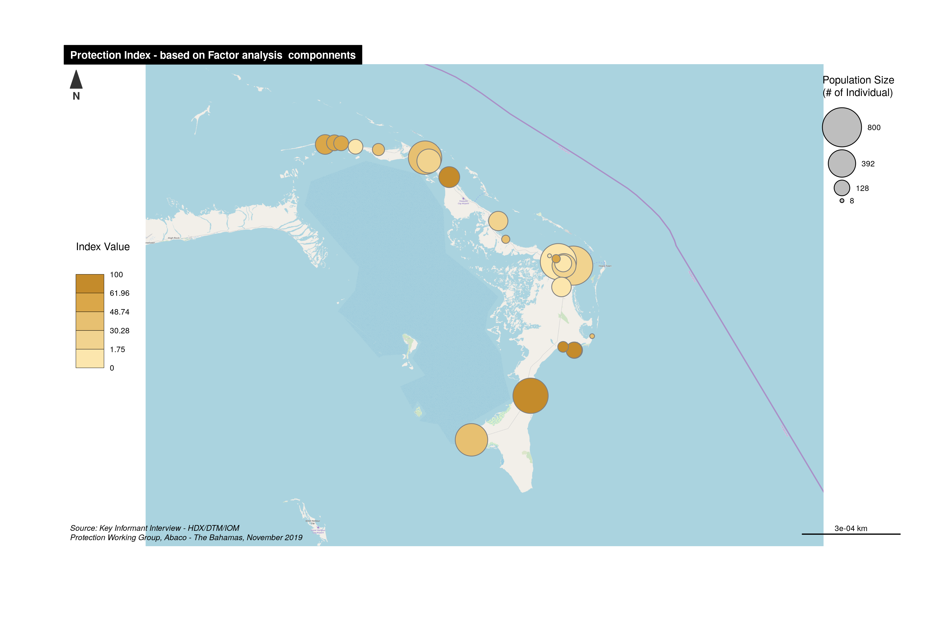
Severity Index Map

Slide 21
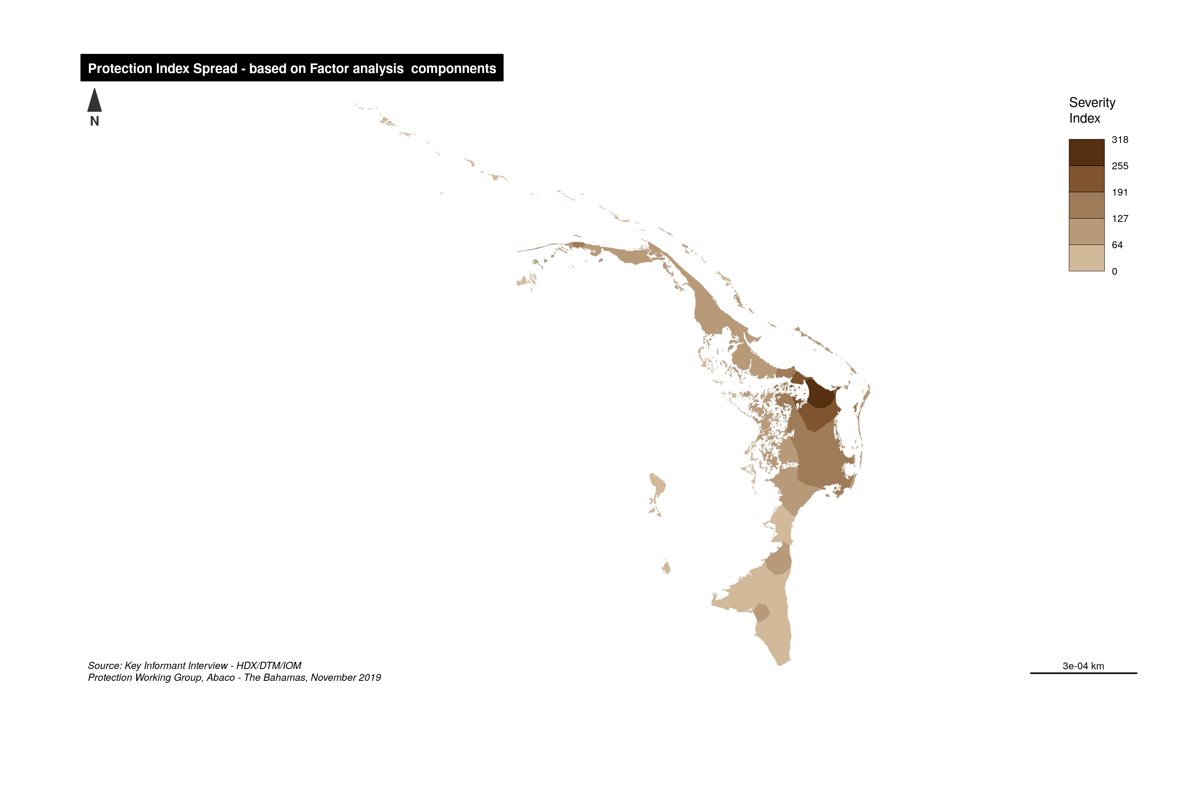
Now getting smooth map

Slide 22
Geometric aggregation

Slide 23
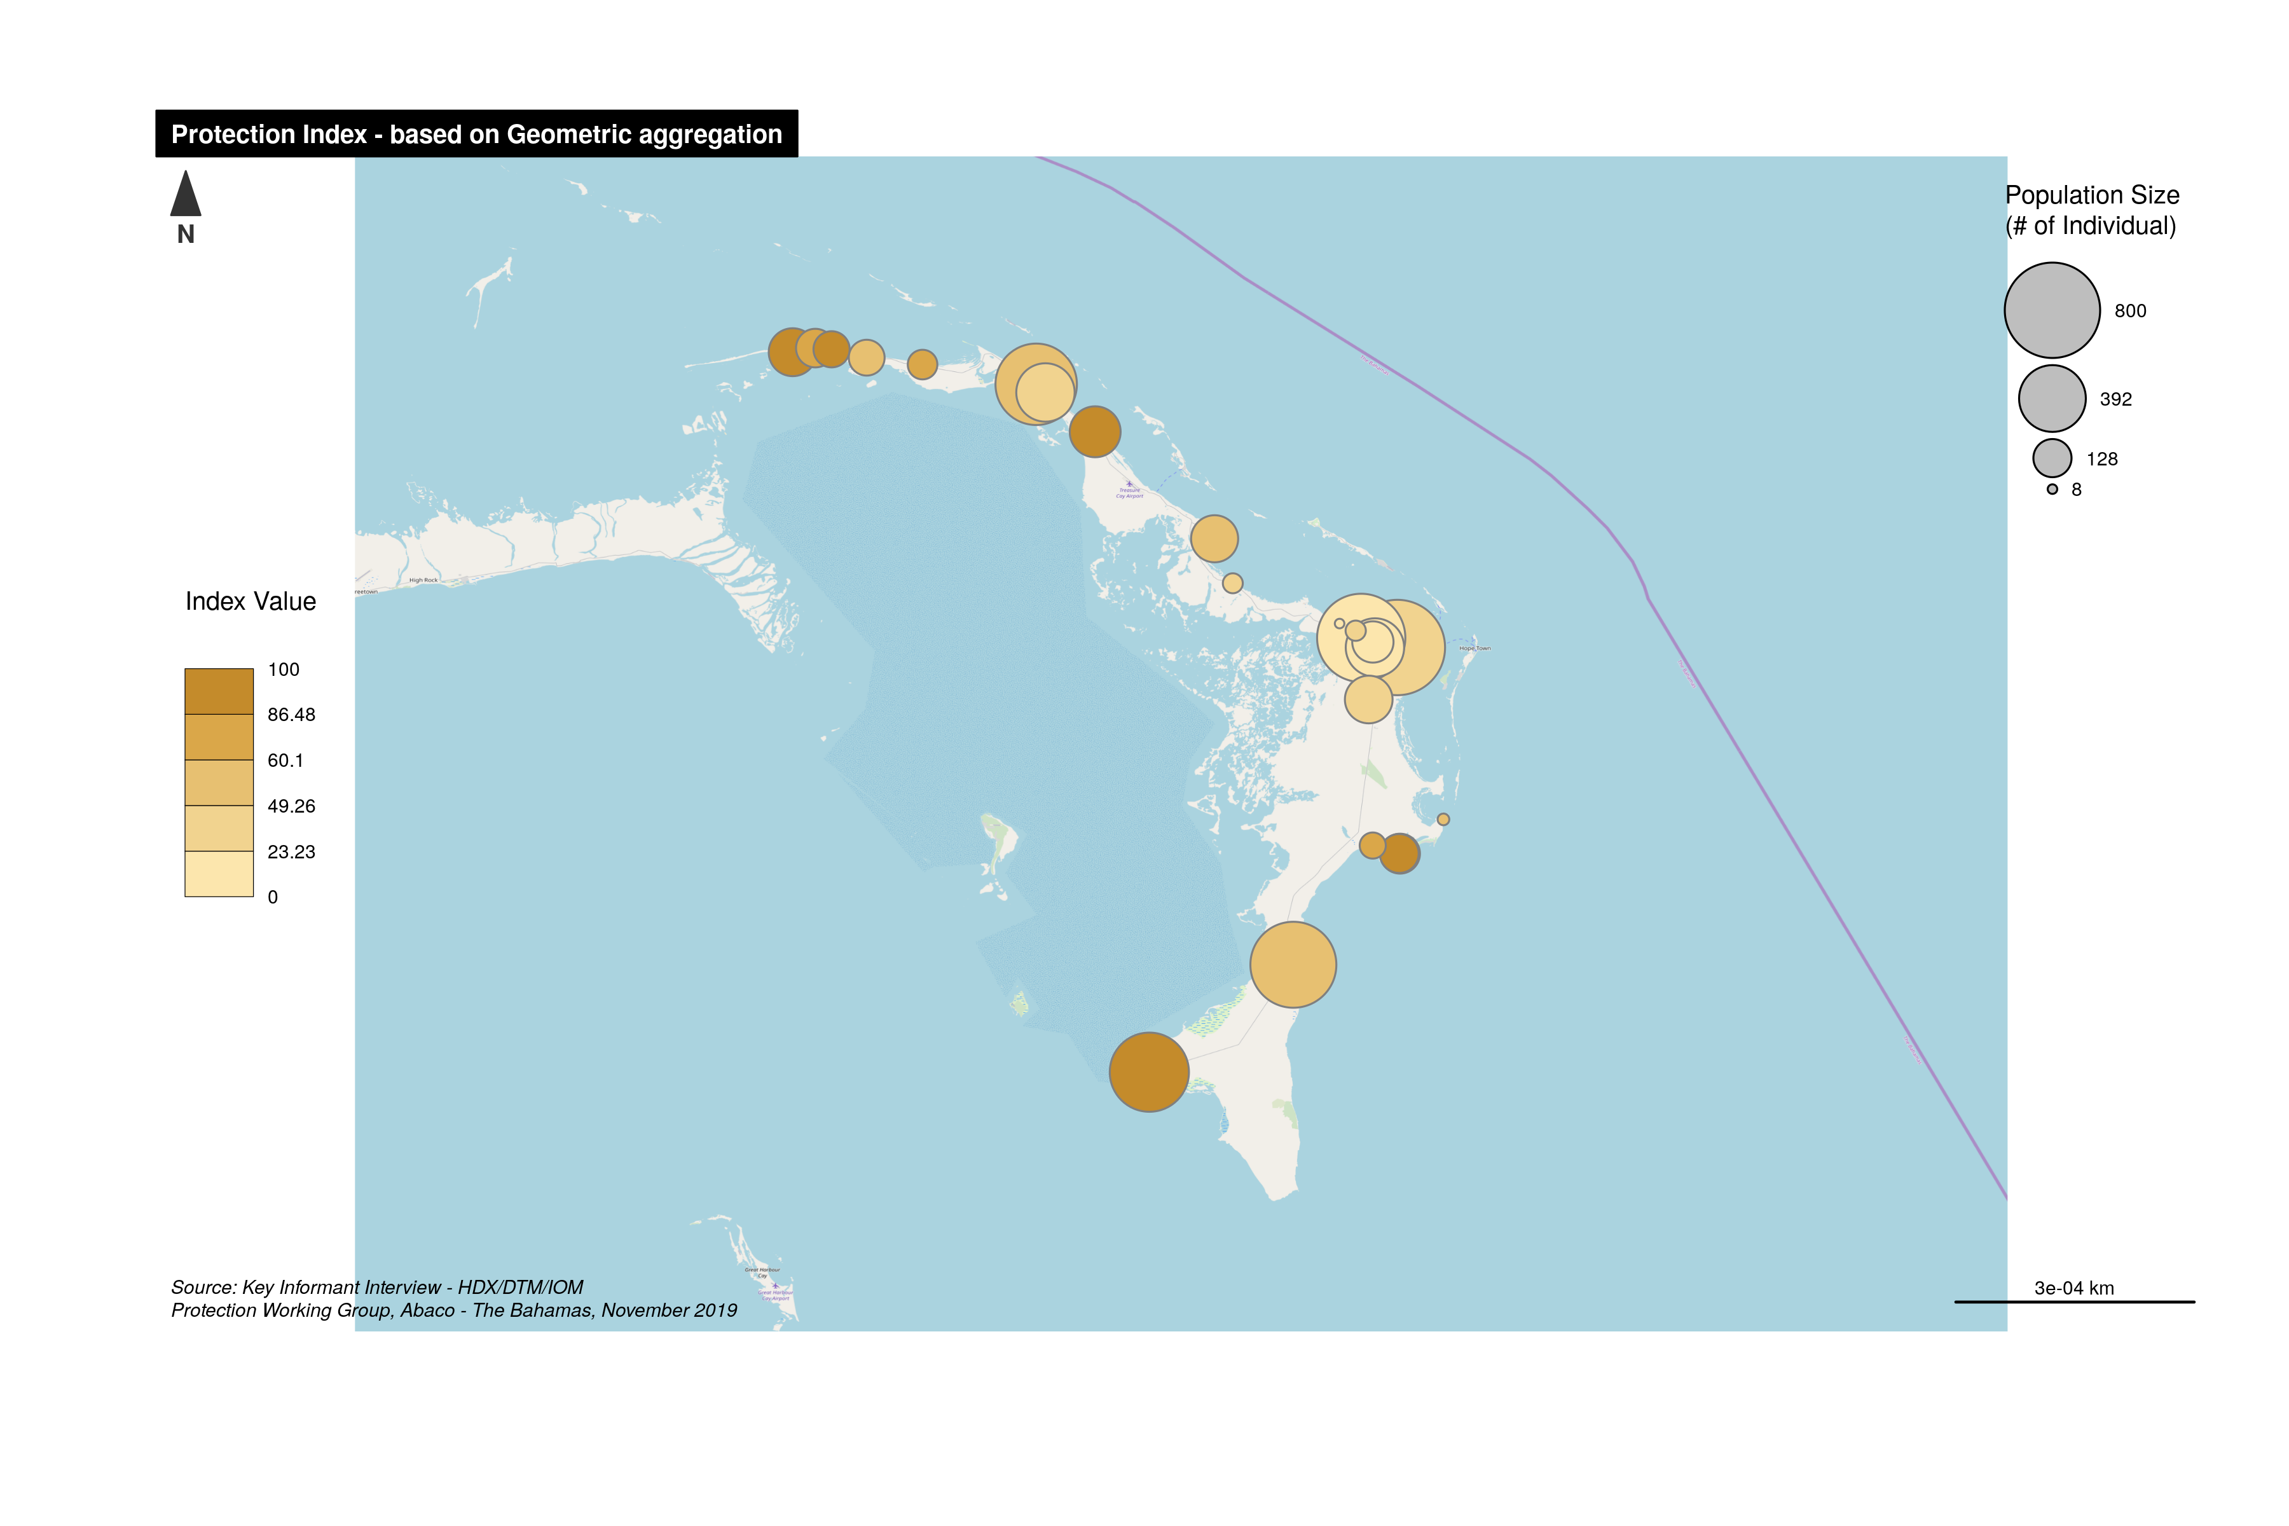
Severity Index Map

Slide 24
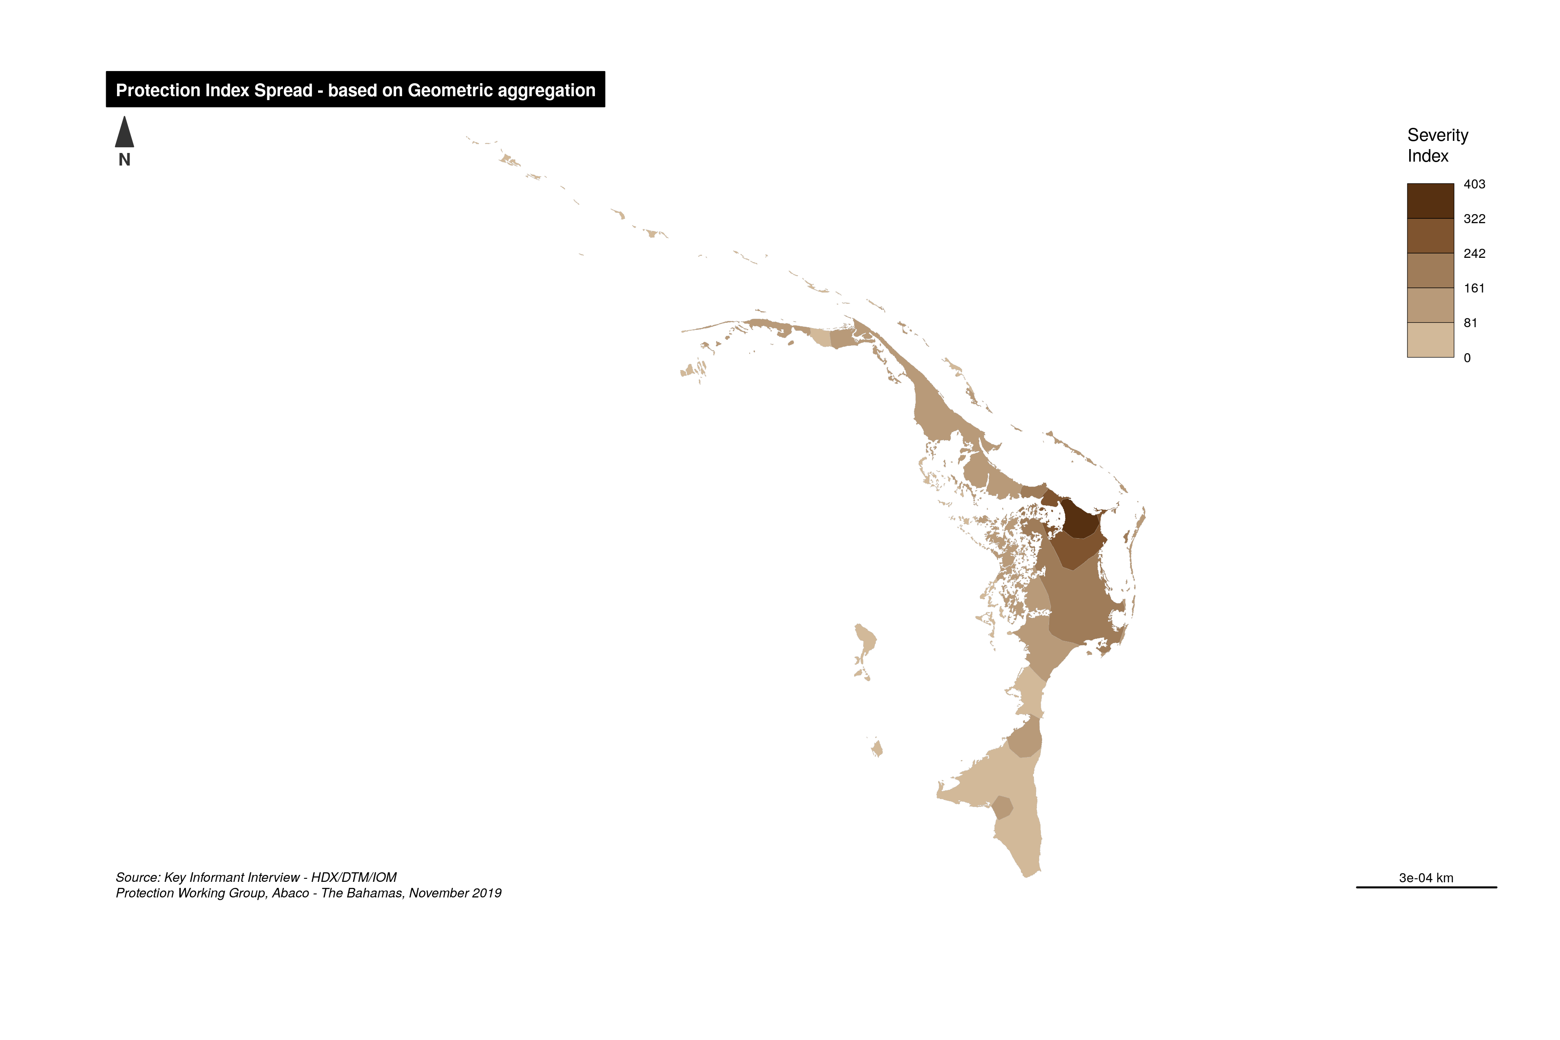
Now getting smooth map

Slide 25
Mean-Min Function

Slide 26
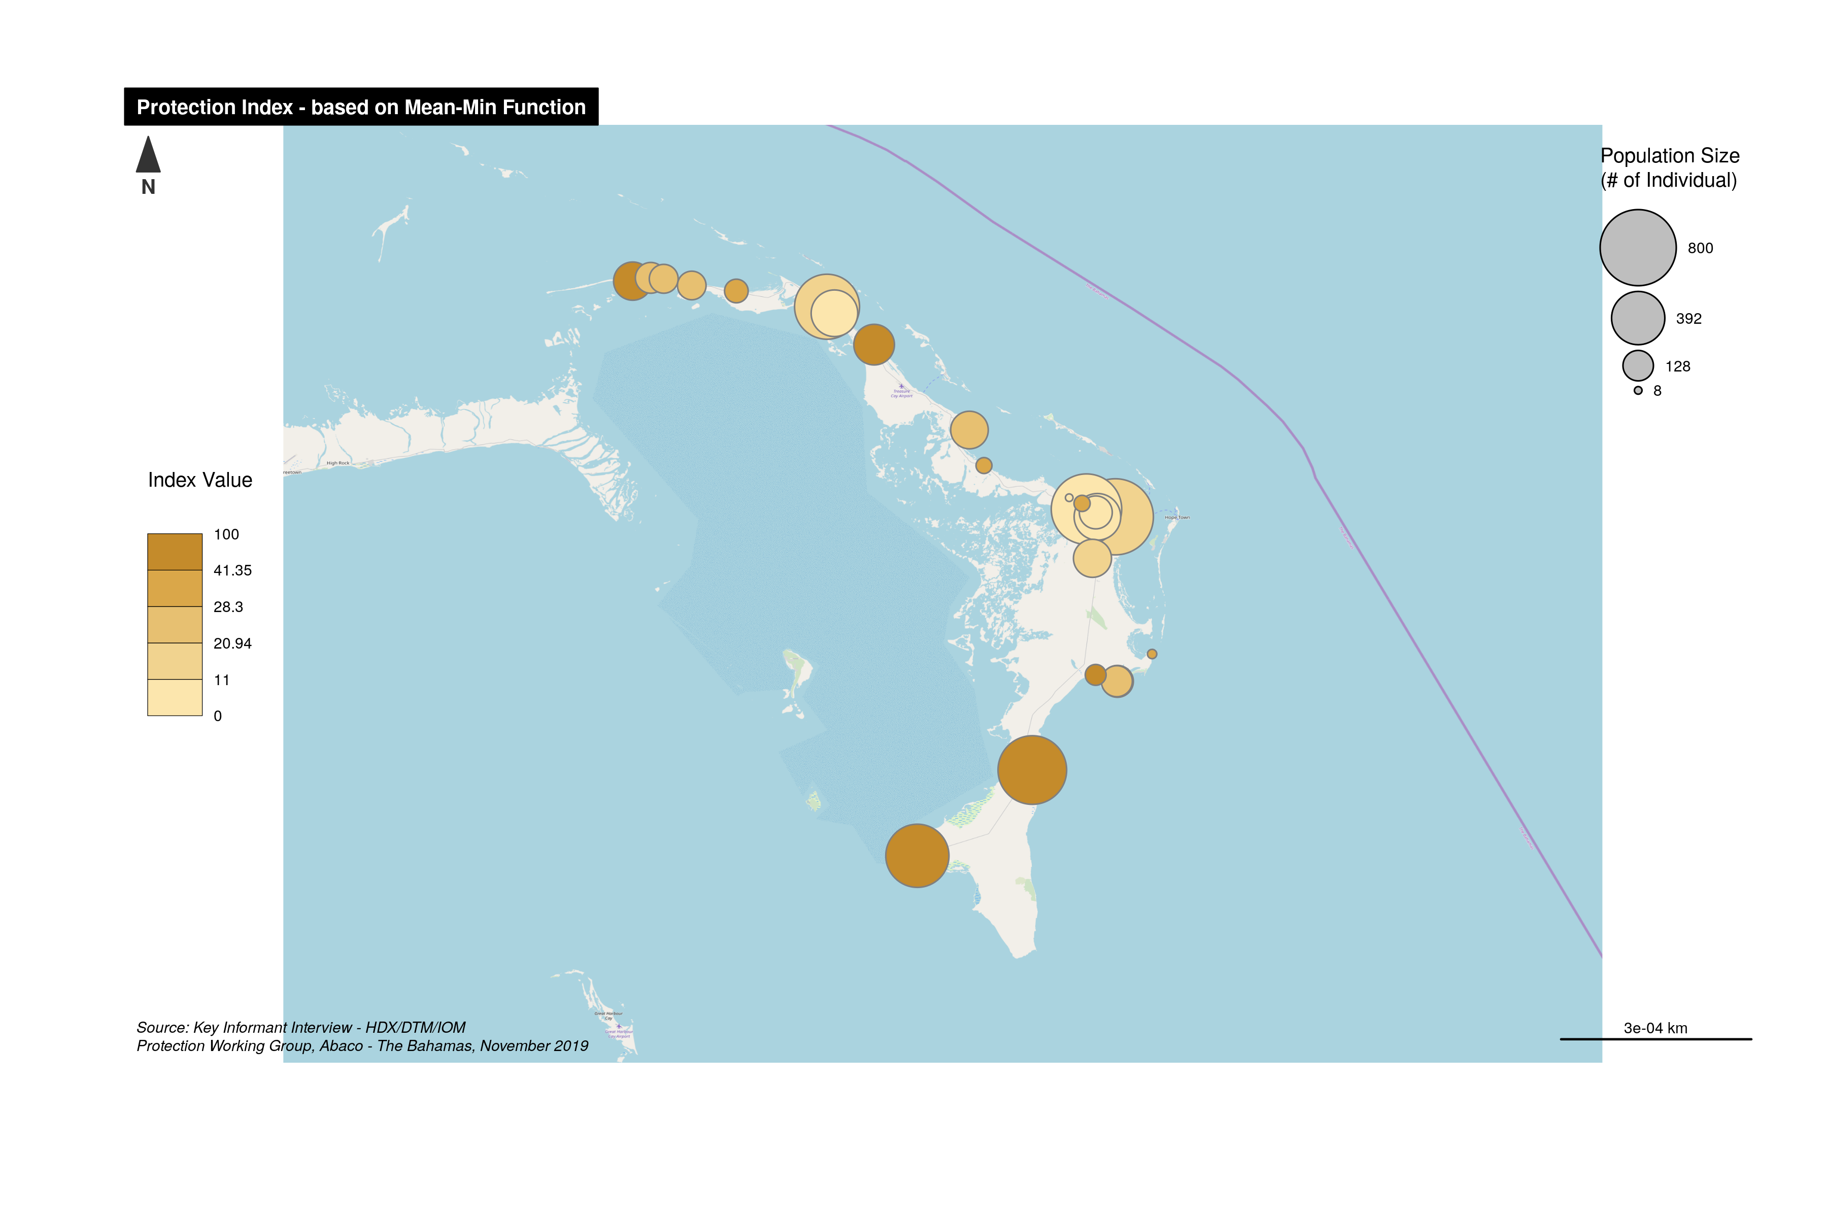
Severity Index Map

Slide 27

Now getting smooth map

Slide 28
Mazziotta-Pareto Index

Slide 29
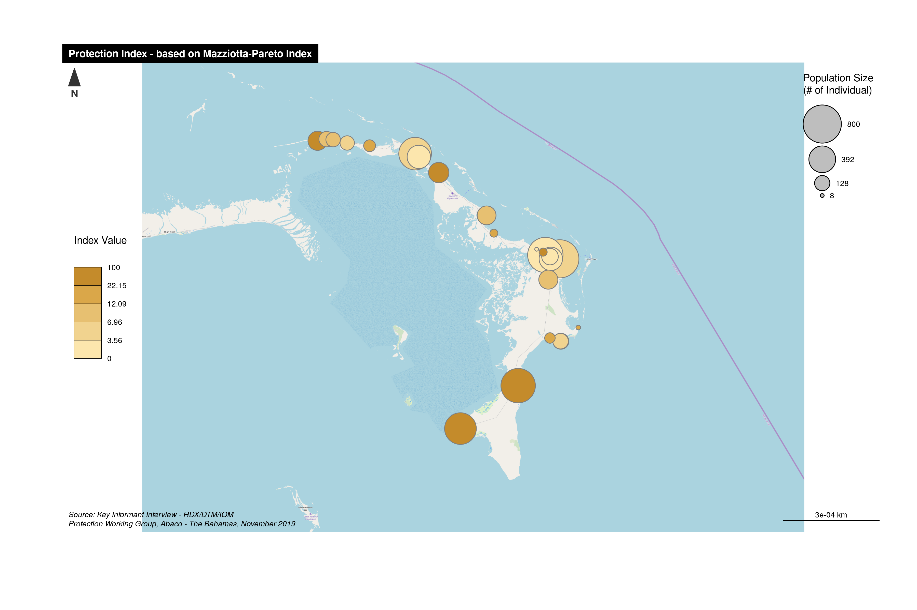
Severity Index Map

Slide 30
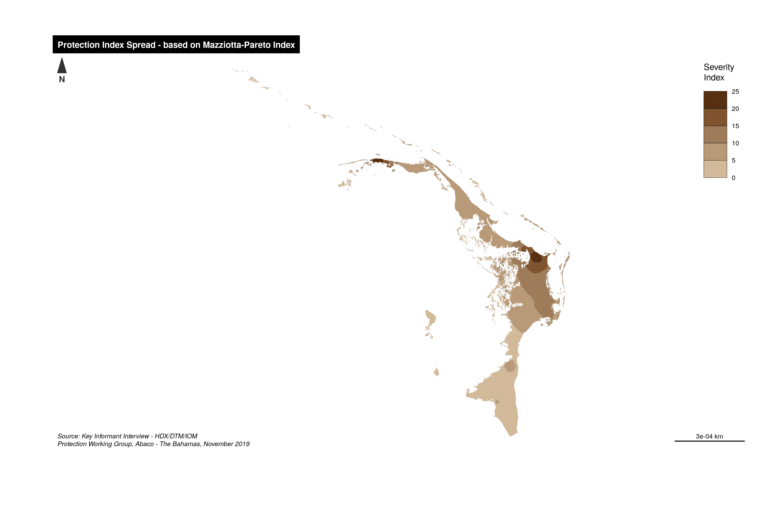
Now getting smooth map

Slide 31
Wroclaw taxonomy method"

Slide 32
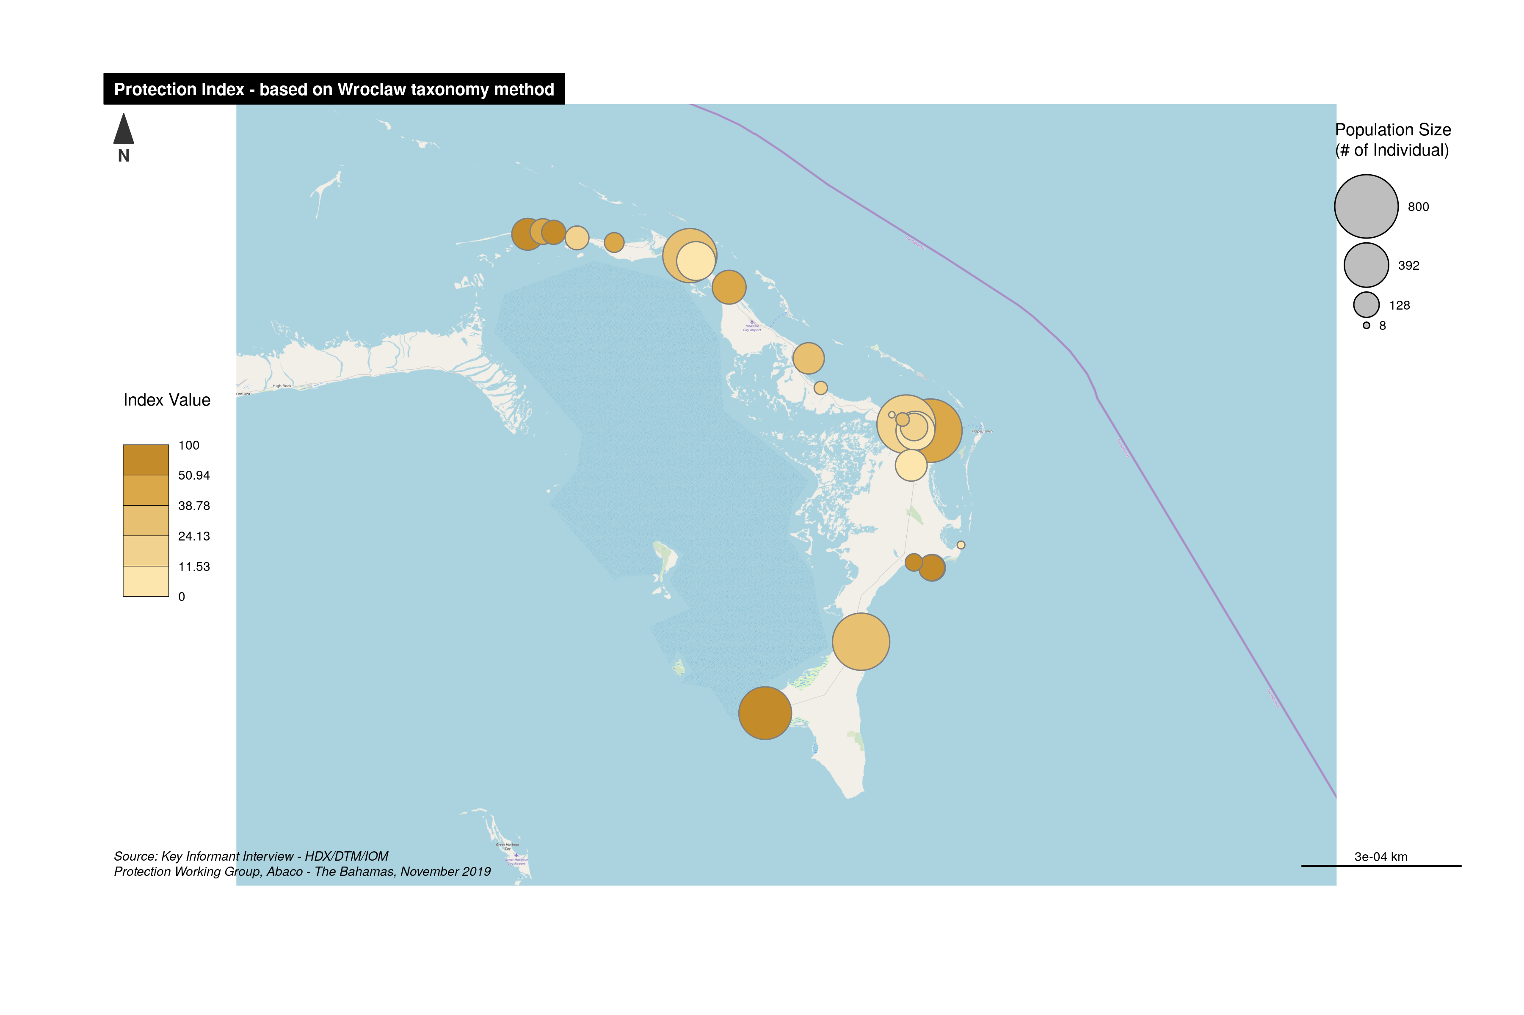
Severity Index Map

Slide 33
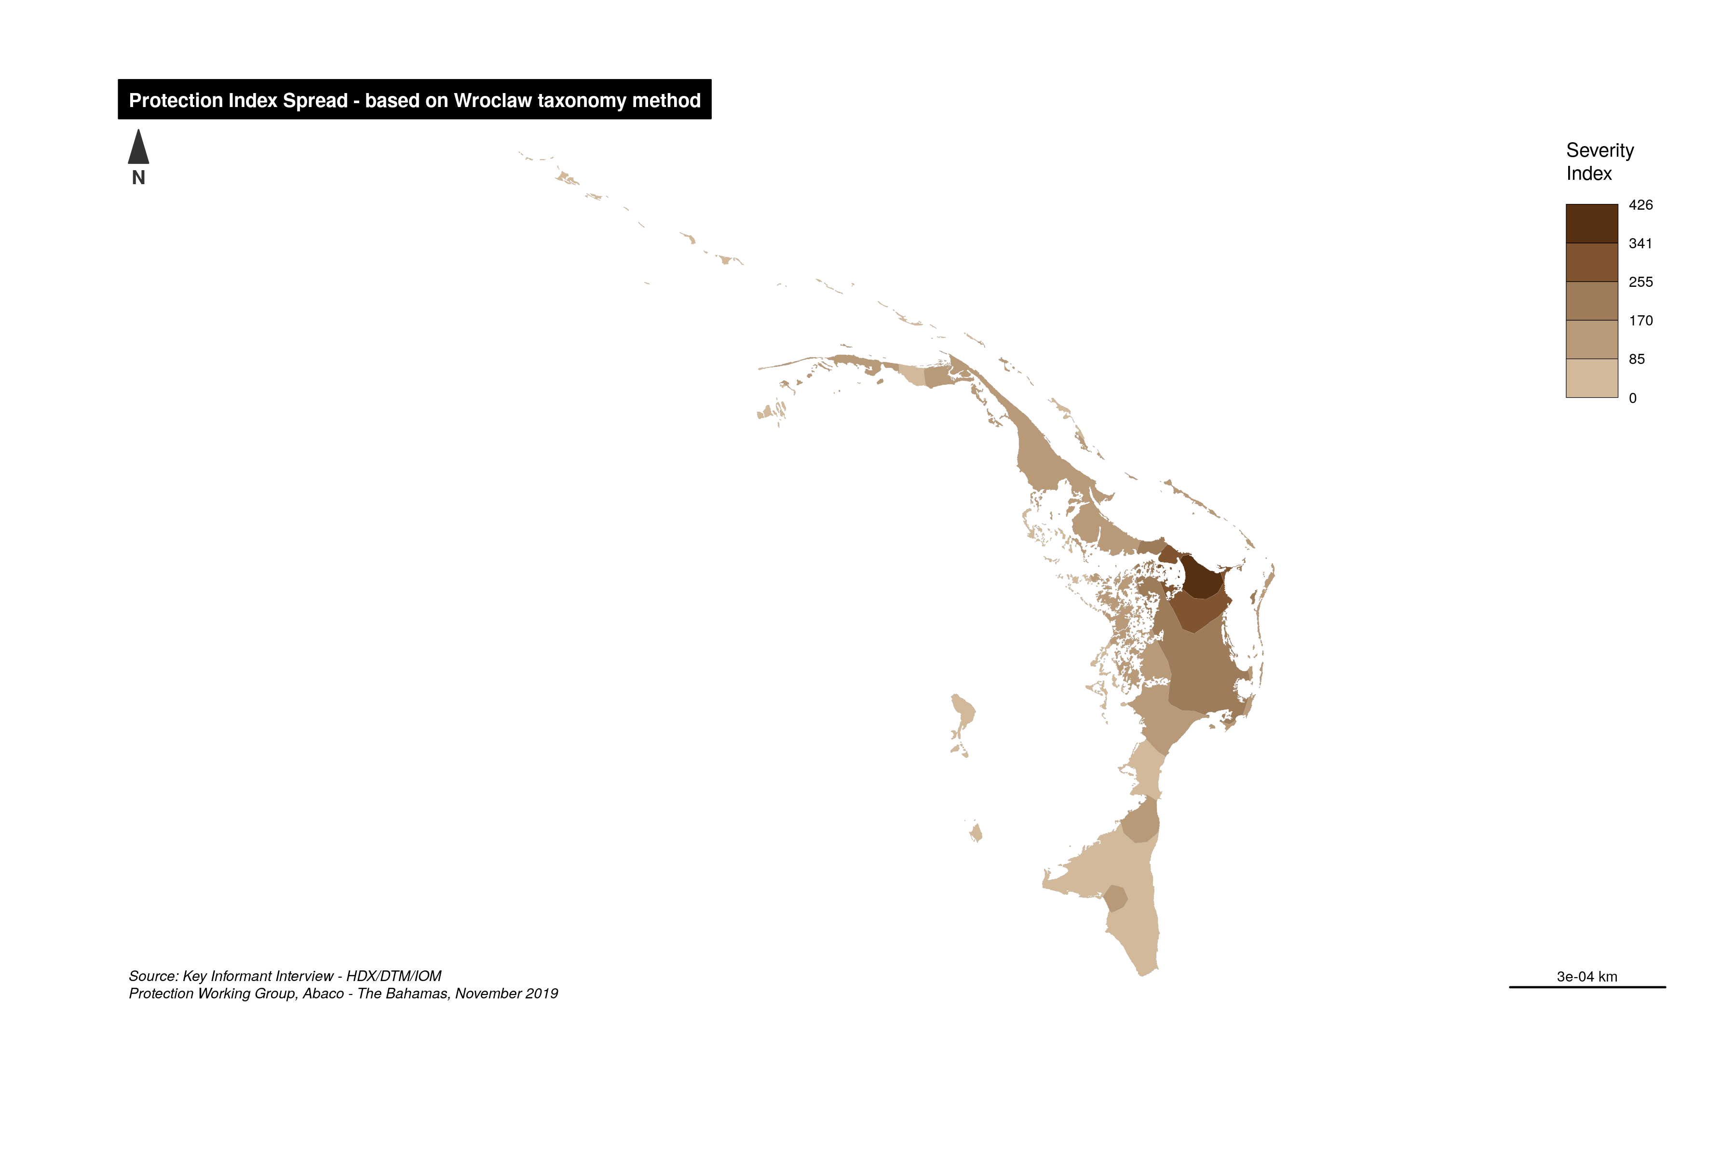
Now getting smooth map

